Slide 1


Personal Financial Literacy Optimizer
Group 5: Wilson Huang, Khoa Nguyen, Shaan Shah, Vignesh Jayananth, Bokai Hu
Notes:
Hi everyone my name is wilson, the final project our group choose to do is a personal Financial Literacy Optimizer.

Slide 2
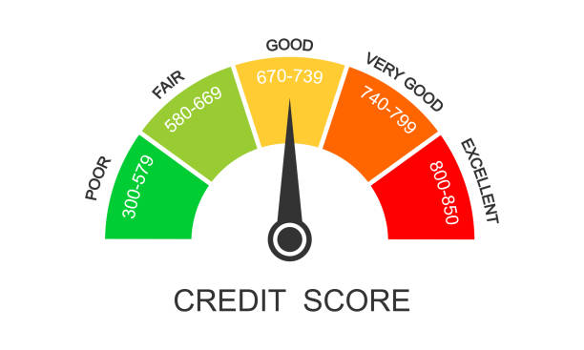

Motivation
Credit Score: score used by creditors to determine credit behavior
Factors that generally affect credit score
Payment History
Amount Owed / Credit Utilization Ratio
Some aspects of our lives can indirectly affect credit score
Lifestyle Choices
Hard Inquiries will lower one’s credit scores
Notes:
Script: Our motivation comes from the importance of credit scores. Credit score is a metric used by creditors to determine the credit behavior of an individual. There are many factors that generally affect credit scores, such as loan payment history, credit utilization ratio and so on. For instance, hard inquiries such as request to increase credit limit will lower scores. The score can be utilized by both financial institutions and individuals to determine how favorable a financial loan could be to that individual. However, due to the many factors involved in determining it, many people do not know how to optimize their score to get the most investment benefit.

Slide 3
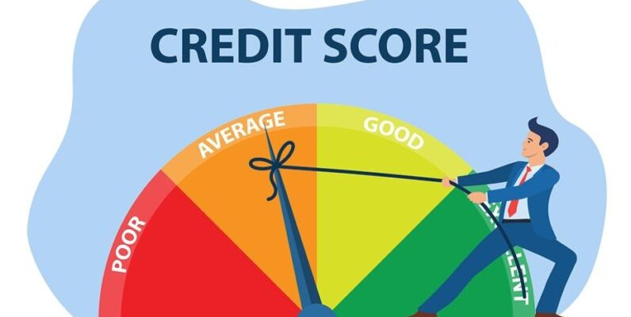
Data Overview
Credit Score Classification:
https://www.kaggle.com/datasets/parisrohan/credit-score-classification?select=train.csv
100,000 data points
28 features
Basic bank details and credit-related information
Dataset Features:
Name, Age, Occupation
Annual Income, Monthly In-Hand Salary
Number of Bank Accounts, Credit Mix
Outstanding Debt, Credit Utilization Ratio
Credit History Age, Payment of Min Amount
EMI per Month, Amount Invested Monthly
Payment Behavior, Monthly Balance
Credit Score
Notes:
Driven by the motivation, we aim to use data sets that encompass diverse factors that affect one’s credit score. The data set we choose is credit score classification from Kaggle. The data set contains many data points and features including Number of bank accounts, credit mix, and Credit utilization ratio and many more.

Slide 4
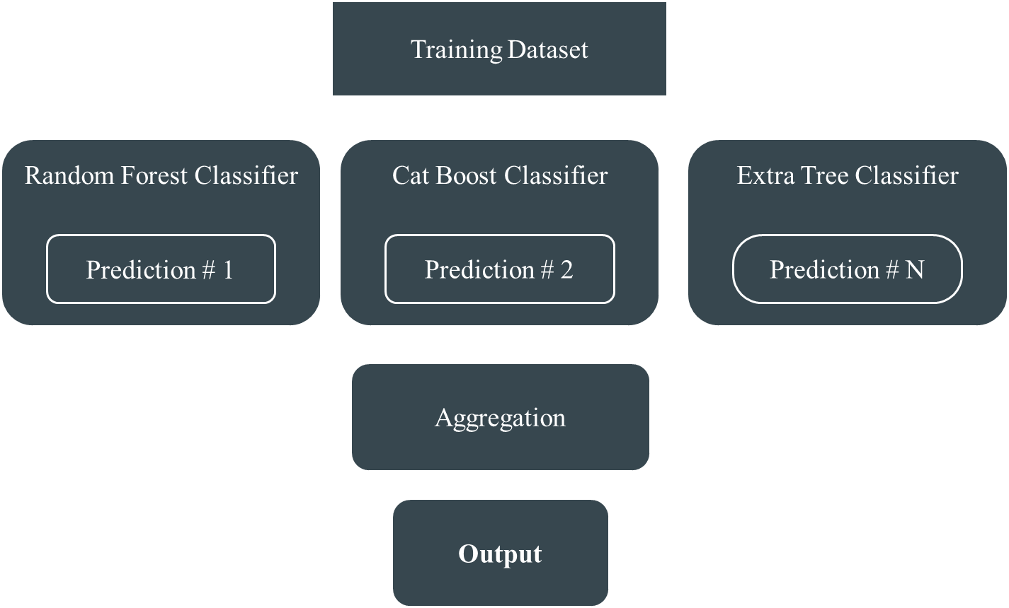
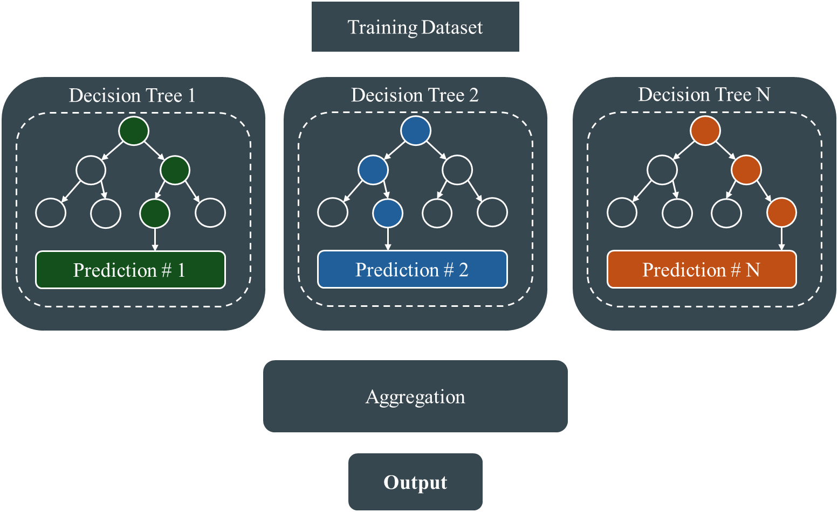
The Project Pipeline
Credit Score Classification Database
Data Preprocessing
Feature Extraction
ML Model Decision
Personal Finance Optimizer
Ensemble Classifier
Extra Tree Classifier
Notes:
Bokai:
Our project pipeline starts with downloading data from the database, then moves on to cleaning and preparing it. After that, we extract key features needed for building our models. We then test several models, including the Extra Tree Classifier and an Ensemble Classifier, and choose the best one based on accuracy and F1 score. In the end, we created a Personal Finance Optimizer that gives advice on how to improve credit scores.

Slide 5
Methodology
Data cleaning and data preprocess
Modeling
Reverse optimization
What Can’t People Change?
Name, Age, Occupation
Annual/Monthly Income
Extra Tree Classifier
Notes:
Bokai
We begin by converting string and categorical variables into numerical labels and removing any unnecessary characters. We use quantile to exclude outliers. Once the data is cleaned, we select features most relevant to credit scores and use them to train our models.
We chose the Extra Tree Classifier because it provide the best performance in terms of accuracy and F1 score during evaluation. Following this, we apply Bayesian optimization to identify the best values for user-adjustable features, allowing us to provide tailored suggestions for improving credit scores.

Slide 6
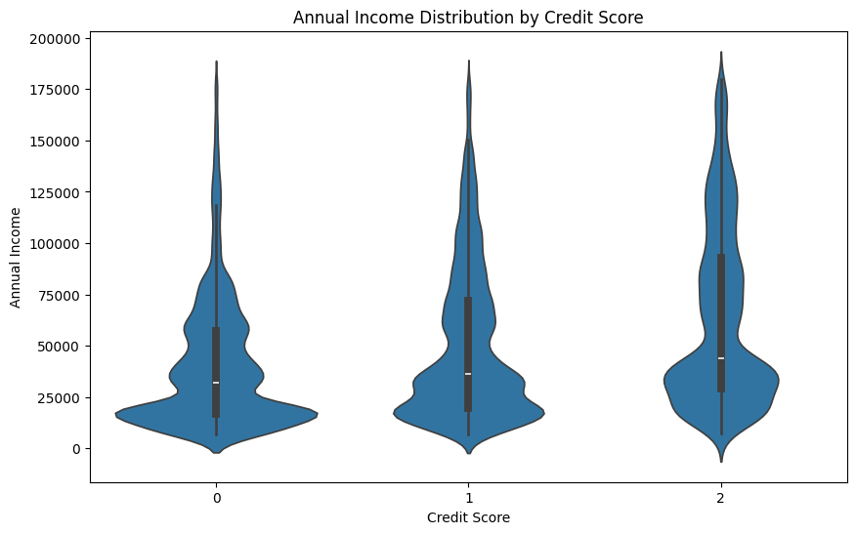
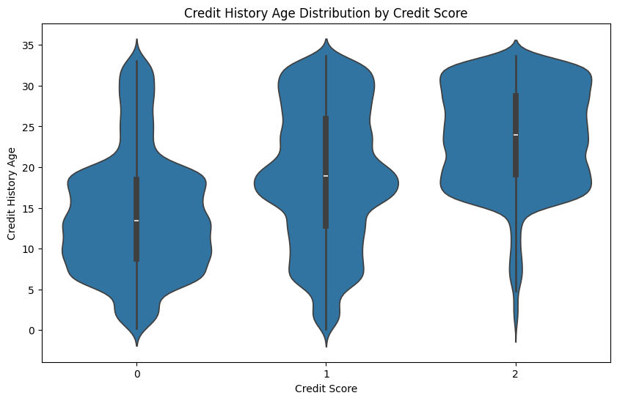
Data Analysis (1): Feature Selection
What are the some of the most important features?
Payment of Min Amount
Number of Credit Card Inquiries
Delay from Due Date
Number of Credit Cards
Note: Some features like Annual Income cannot be easily changed
Notes:
Khoa After processing the data, we move onto our data analysis. First, we analyze what are the most important features that influence credit score. In the two plots at the right, we can see two of the different features and their distribution based off of credit score. In the graphs, 0 indicates a poor credit score, 1 is a standard credit score and 2 is a good credit score.. We can see a big difference in the distribution of credit history age for credit score, with those who have more credit history will most likely have a better credit score.

Slide 7
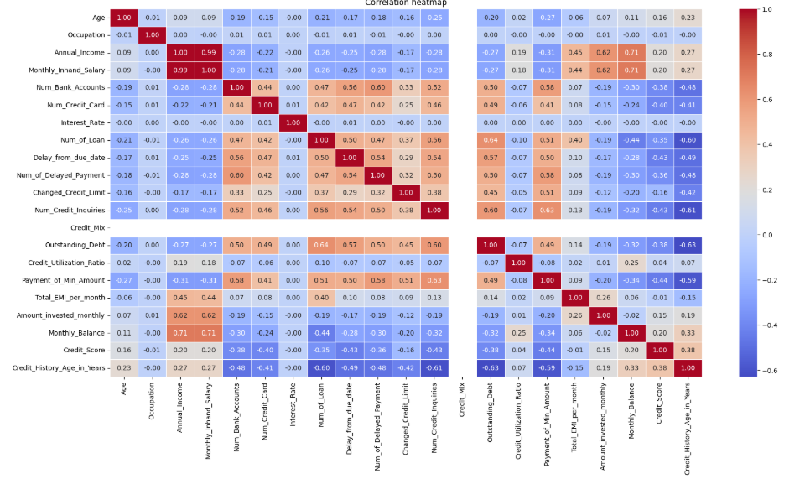
Correlation Heatmap
Notes:
Khoa
In this correlation heatmap between the different features when compared to credit score, we can see the positive and negative correlation at the second-to-bottom row. In this case, we can see that features such as credit history is positively correlated at 0.38 with credit score while features such as number of credit cards and the delay from due dates are the most negatively correlated at around -0.40 and -0.43 respectively. This will be used by our model to show which are the most important features to decrease in order to improve one’s overall credit score.

Slide 8
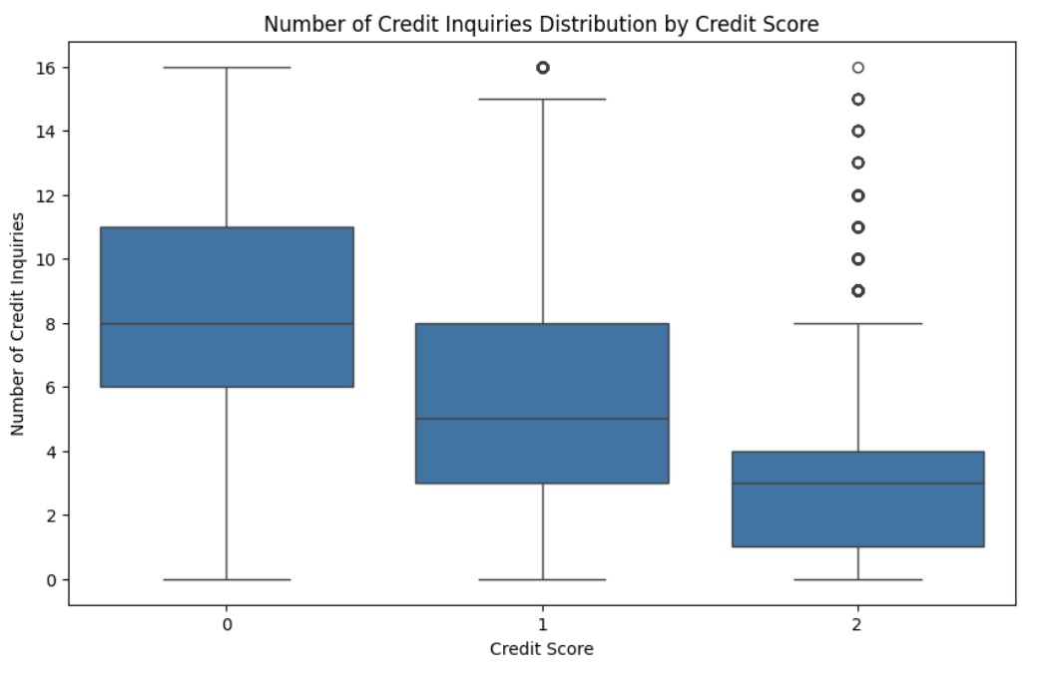
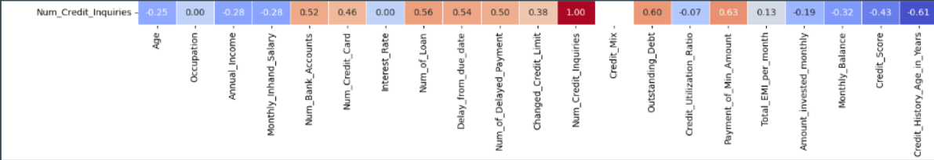
Data Analysis (2): Correlations
How do credit inquiries indicate financial behavior?
Bad behaviors have positive correlation
Hard Inquiries lower credit score
Notes:
Vignesh: Another question we ask is how do credit inquiries indicate financial behavior. In other words, how does number of credit inquiries correlate with the other features and credit score. From the heat map, we can see that number of credit inquiries has a positive correlation with generally negative behaviors like number of delayed payments. We also looked at credit inquiries and their effect on credit score. We can see that having higher number of credit inquiries usually leads to lower credit scores. This makes sense as credit scores are often lowered after an inquiry.

Slide 9
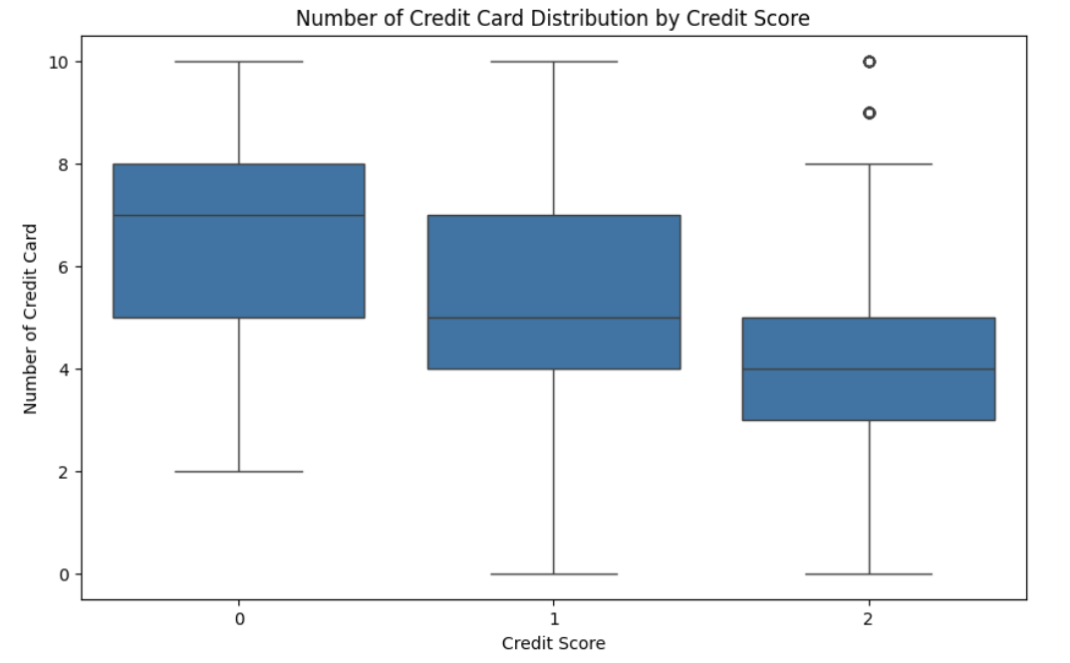
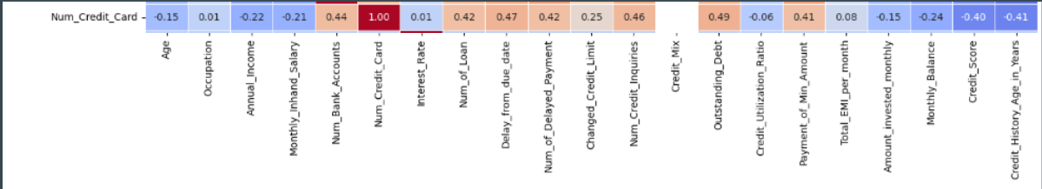
Data Analysis (3): Correlations
How do number of credit cards indicate financial behavior?
Bad Behaviors have positive correlation
People with more credit cards tend to have bad credit scores
Notes:
Vignesh: The next question we looked at was, how do number of credit cards indicate financial behavior? Similar to number of credit inquiries, we noticed that number of credit cards had a positive correlation with negative behaviors. We also looked at how number of credit cards correlated with credit score. When looking at number of hard inquiries, we saw that number of hard inquiries leads to lower credit scores which makes sense as it has a direct effect. This feature was more interesting as number of credit cards generally has no direct influence on credit scores. We noted that higher number of credit cards generally correlates with lower credit scores.

Slide 10
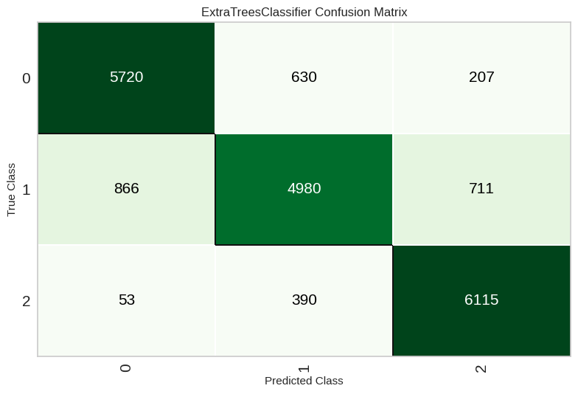
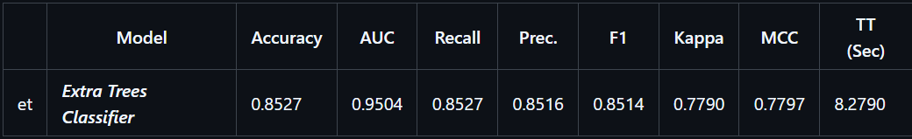
Data Analysis (4): Choosing the Best Model
How accurate is the best model?
ExtraTreeClassifier performed the best
Accuracy and F1 score of over 85%
Notes:
Vignesh: To select the best model, we tested various structures and hyperparameters, including Support Vector Machine, Random Forest, Extra Tree, and Ensemble Classifier. For SVM, we evaluated different kernels and slack variables; for Random Forest and Extra Tree, we tested the number of estimators and max depth; and for the ensemble model, various classifier combinations. Ultimately, the Extra Tree Classifier performed best, achieving over 85% accuracy and F1 score on both the validation and test sets. Here is the confusion matrix of our extra trees classifier. Note that our model was least accurate when the true credit score was standard which makes sense as this is the hardest to predict in general.

Slide 11
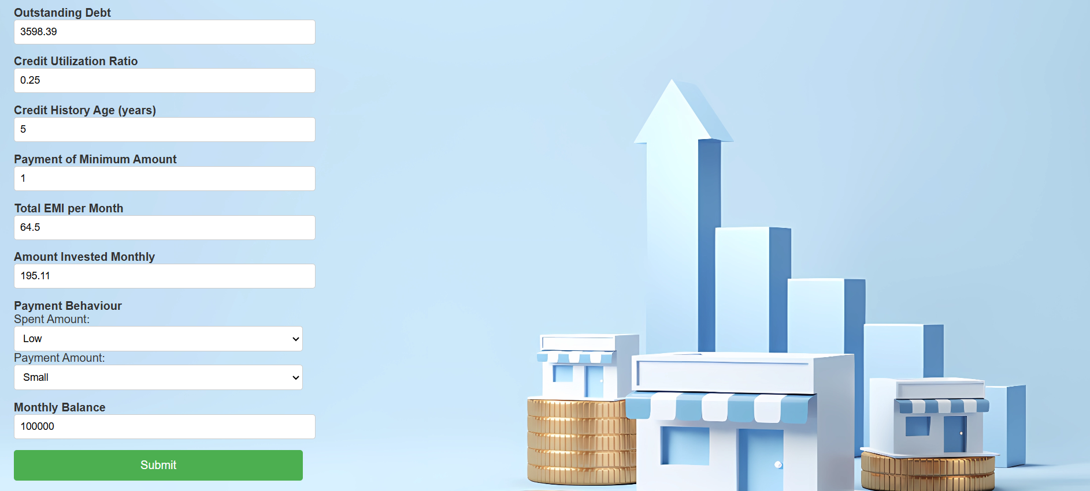
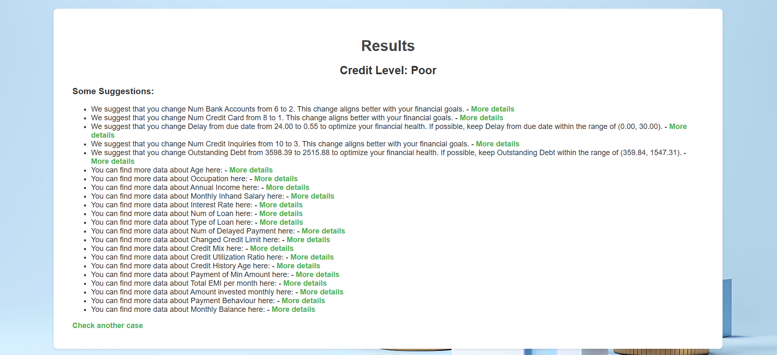
The Financial Optimizer Website for Users
Notes:
Here’s our website that host the product of our data analysis, we’ve already input some data beforehand, and now I’m gonna put in the rest to demonstrate.
We used flask to build the website and it takes in the value and calls the model to perform the prediction. We also used html for formatting.
The model will evaluate this person’s credit score and give feedback such has potential improvements and resources to look at.
The goal of building a website is to create an application where people can evaluate their financial situations with ease.

Slide 12
Conclusions
Many different features can negatively impact or positively affect one’s credit score despite not having a direct relationship.
For example, number of credit cards does not always negatively impact credit score if one pays off all their credit card debt in time
Encourages bad practices (Increased credit inquiries, outstanding debt)
Our goal is to use the data analysis on the features and give positive feedback on how to change different features to improve credit score
Decreasing Number of Credit Cards, Decreasing Outstanding Debt

Slide 13
Thank You!
Any Questions?

